Slide 1
Confident conversations Talking with non believers
2: WHY DO PEOPLE SUFFER?

Slide 2
CONFIDENT CONVERSATIONS 2: WHY DO PEOPLE SUFFER?
Last time
1: WHO ARE THESE PEOPLE?!

Slide 3
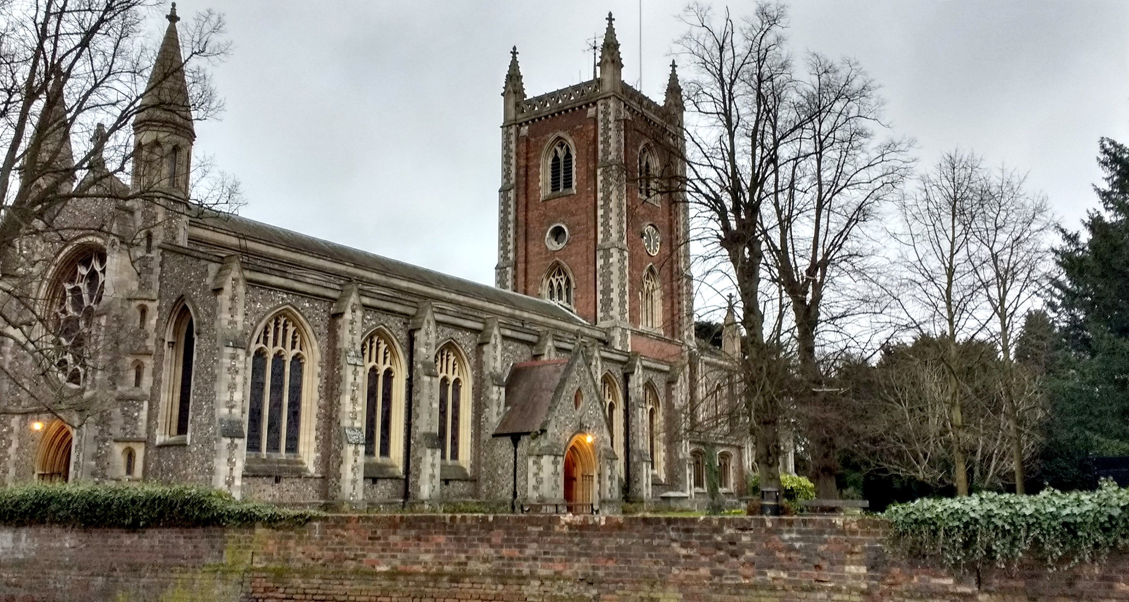
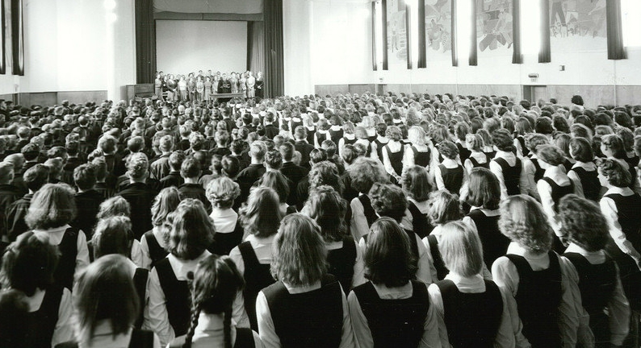
CONFIDENT CONVERSATIONS
Britain is changing – the separation of the world from the Word
Last time
1: WHO ARE THESE PEOPLE?!

Slide 4
CONFIDENT CONVERSATIONS
Britain is changing – the separation of the world from the Word
The battle is won in the air
Last time
1: WHO ARE THESE PEOPLE?!
Ephesians 6:12

Slide 5
CONFIDENT CONVERSATIONS
Britain is changing – the separation of the world from the Word
The battle is won in the air
Ground Rules
Last time
1: WHO ARE THESE PEOPLE?!

Slide 6
CONFIDENT CONVERSATIONS
Britain is changing – the separation of the world from the Word
The battle is won in the air
Ground Rules
Last time
1: WHO ARE THESE PEOPLE?!
1: The person is more important than their question
2: The answer might be another question
3: Prayer is paramount
4: Un-believers are seen as lost
5: Lost people are still of infinite worth
6: Lost people are lost, however it might seem.
7: Lost people need help

Slide 7
CONFIDENT CONVERSATIONS THE QUESTIONS
From my limited survey, these are the question areas:
Evil & Suffering
Science vs Faith
The Bible
Jesus the only way
The Church
Life after Death
Sexuality

Slide 8
CONFIDENT CONVERSATIONS 2: WHY DO PEOPLE SUFFER?
WHAT’S THE PROBLEM?
Philosophical definitions
Natural evil - suffering caused by events that have nothing to do with humans, and which are to do with the way the world is, e.g. natural disasters such as volcanic eruptions, floods or earthquakes
Moral (or human) evil - suffering caused by humans acting in a way that is considered morally wrong e.g. bullying, murder, rape, theft or terrorism

Slide 9
CONFIDENT CONVERSATIONS 2: WHY DO PEOPLE SUFFER?
WHAT’S THE PROBLEM?
Typical philosophical approach
God is all loving
The
Inconsistent
Triad
God is all powerful
Evil exists
J.L. Mackie in 1977

Slide 10
CONFIDENT CONVERSATIONS 2: WHY DO PEOPLE SUFFER?
IT’S WORSE THAN THAT THOUGH
God is all loving
The
Inconsistent
Triad
God is all KNOWING God is all PRESENT
God is all powerful
Evil exists

Slide 11
CONFIDENT CONVERSATIONS 2: WHY DO PEOPLE SUFFER?
THE PROBLEM
EVIL EXISTS WHILE...
God is all POWERFUL So he could put a stop to any evil, suffering, etc.
God is all KNOWING So he is not ignorant of the suffering
God is all PRESENT So he’s not unavailable
God is all LOVING So it’s not as if he doesn’t care. How does he live with himself?!

Slide 12
CONFIDENT CONVERSATIONS 2: WHY DO PEOPLE SUFFER?
UNPACKING THE PROBLEM FURTHER
Imagine you see someone in pain at a car crash and you...
... have the power to fix the problem – perhaps you have some medical supplies with you
... know all about the problem – maybe you’re a doctor and you know the person as a friend
... are present at the scene
... love the person who is in pain
Wouldn’t you help?
God is all POWERFUL
God is all KNOWING
God is all PRESENT
God is all LOVING

Slide 13
CONFIDENT CONVERSATIONS 2: WHY DO PEOPLE SUFFER?
WHAT’S THE PROBLEM?
Traditional Christian responses
The Fall
Free Will
Soul Making

Slide 14
CONFIDENT CONVERSATIONS 2: WHY DO PEOPLE SUFFER?
WHAT’S THE PROBLEM?
Traditional Christian responses
don’t always help the intelligent, possibly hurting, non believer
The Fall from a non believer’s perspective
“So people suffer because a talking snake told the only woman alive to eat some fruit. She shared it with her husband, the first man. I looked that up and it says the only punishments God dished out were that the serpent has to crawl on its belly, the woman will have pains in childbirth and the man will have to sweat and dig up weeds if he’s to grow any food. There’s nothing there about earthquakes, tsunamis and other natural disasters being a result of this so called Fall. It’s not just the snake that doesn’t have a leg to stand on...”

Slide 15
CONFIDENT CONVERSATIONS 2: WHY DO PEOPLE SUFFER?
WHAT’S THE PROBLEM?
Traditional Christian responses
don’t always help the intelligent, possibly hurting, non believer
Free Will from a non believer’s perspective
“I get that God didn’t want robots and gave us free will. But don’t you Christians believe he sometimes intervenes to rescue his children? Couldn’t he do that just a bit more? Or at least put a boundary on our behaviour? I want my kids to make choices for themselves, but I’m not going to let them hurt anyone else or cross the road without me. Seems your Father God is a negligent parent as he’s a bit too relaxed about the free will he gives us and hasn’t really thought the consequences through...”

Slide 16
CONFIDENT CONVERSATIONS 2: WHY DO PEOPLE SUFFER?
WHAT’S THE PROBLEM?
Traditional Christian responses
don’t always help the intelligent, possibly hurting, non believer
Soul Making from a non believer’s perspective
“So suffering makes us better. Over 800 million people suffer from hunger worldwide. Around 9 million of them die every year. Tell them that suffering is good for the soul. I’ve heard it said if something doesn’t kill you it makes you stronger. Is that really always true? And what if it does kill you?”

Slide 17
CONFIDENT CONVERSATIONS 2: WHY DO PEOPLE SUFFER?
THE REAL PROBLEM
God is all POWERFUL
God is all KNOWING
God is all PRESENT
God is all LOVING
We are viewing God as if he’s a human.
He’s not.
My dog does not expect me to behave like a dog.
I’m not a dog and I won’t go around on all fours and eat out of a bowl on the floor.
ME
MY DOG

Slide 18
CONFIDENT CONVERSATIONS 2: WHY DO PEOPLE SUFFER?
THE REAL PROBLEM
GOD
God is all POWERFUL
God is all KNOWING
God is all PRESENT
God is all LOVING
We are viewing God as if he’s a human.
He’s not.
Although we are made in God’s image, he is still far above anything we can imagine in so many ways.
He won’t always behave the way we would expect.
Why?
ME

Slide 19
CONFIDENT CONVERSATIONS 2: WHY DO PEOPLE SUFFER?
THE REAL PROBLEM
God is all POWERFUL
God is all KNOWING
God is all PRESENT
God is all LOVING
We have said that God has all these amazing attributes.
And then we expect to understand him.
Again, my dog cannot make sense of all my actions. Taking him to the vet is a good example!
He can only understand as much of me as his doggy brain will allow.
ME
MY DOG

Slide 20
CONFIDENT CONVERSATIONS 2: WHY DO PEOPLE SUFFER?
THE REAL PROBLEM
GOD
God is all POWERFUL
God is all KNOWING
God is all PRESENT
God is all LOVING
We have said that God has all these amazing attributes.
And then we expect to understand him.
How much stuff do I really know about the world? The universe? Out of all the knowledge there is, I hardly understand or know anything at all. And that is about a finite world.
So how much could I ever grasp of an infinite God?
ME

Slide 21
CONFIDENT CONVERSATIONS 2: WHY DO PEOPLE SUFFER?
THE REAL PROBLEM
God is all POWERFUL
God is all KNOWING
God is all PRESENT
God is all LOVING
In summary...
We have expected God to behave like we do
We have tried to understand God
‘For my thoughts are not your thoughts, neither are your ways my ways,’ declares the Lord. ‘As the heavens are higher than the earth, so are my ways higher than your ways and my thoughts than your thoughts.
Isaiah 55:8-9

Slide 22
CONFIDENT CONVERSATIONS 2: WHY DO PEOPLE SUFFER?
THE REAL PROBLEM
God is all POWERFUL
God is all KNOWING
God is all PRESENT
God is all LOVING
There are many good scholars who CAN demonstrate that Christianity IS a reasonable faith.
But this is not always the best way to navigate a Spirit-led conversation with someone who is asking questions.
Let’s try something else...

Slide 23
CONFIDENT CONVERSATIONS 2: WHY DO PEOPLE SUFFER?
OUR RESPONSE TO QUESTIONS ABOUT SUFFERING
God is all POWERFUL
God is all KNOWING
God is all PRESENT
God is all LOVING
The very attributes of God that seem to contradict the presence of suffering in the world are the reason we have hope.
We take comfort in who he is in the face of the evil and the suffering we can’t always explain.

Slide 24
CONFIDENT CONVERSATIONS 2: WHY DO PEOPLE SUFFER?
OUR RESPONSE TO QUESTIONS ABOUT SUFFERING
God is all POWERFUL
God is all KNOWING
God is all PRESENT
God is all LOVING
Our job is to show a hurting world that we have hope.
Future hope for a perfect afterlife.
I consider that our present sufferings are not worth comparing with the glory that will be revealed in us.
Romans 8:18

Slide 25
CONFIDENT CONVERSATIONS 2: WHY DO PEOPLE SUFFER?
OUR RESPONSE TO QUESTIONS ABOUT SUFFERING
God is all POWERFUL
God is all KNOWING
God is all PRESENT
God is all LOVING
Our job is to show a hurting world that we have hope.
Present hope that God is with us.
³ Praise be to the God and Father of our Lord Jesus Christ, the Father of compassion and the God of all comfort, ⁴ who comforts us in all our troubles, so that we can comfort those in any trouble with the comfort we ourselves receive from God. ⁵ For just as we share abundantly in the sufferings of Christ, so also our comfort abounds through Christ.
2 Corinthians 1:3-5

Slide 26
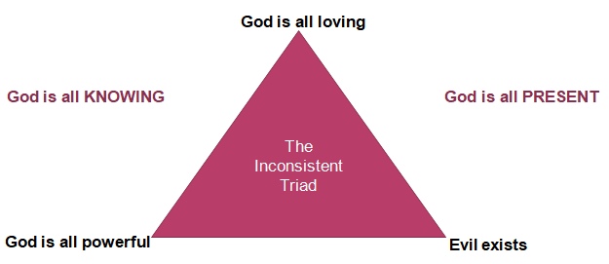
CONFIDENT CONVERSATIONS 2: WHY DO PEOPLE SUFFER?
OUR RESPONSE TO QUESTIONS ABOUT SUFFERING
Evil exists, but thank God he is present in my suffering.
I trust in his love to see me through. He will never leave me nor forsake me.
I’m so glad I have a God who is all knowing. He knows my suffering, he understands my pain.
I believe in his power to put things right, if not now, in the future.

Slide 27
CONFIDENT CONVERSATIONS 2: WHY DO PEOPLE SUFFER?
OUR RESPONSE TO QUESTIONS ABOUT SUFFERING
One thing a non believer can’t argue with is your experience.
Your story is powerful.
Try and share how, although you don’t have all the answers, you have seen God work in your life.
Ask the Holy Spirit to make God known to them, the way he has for you.
Evil exists, but thank God he is present in my suffering.
I trust in his love to see me through. He will never leave me nor forsake me.
I’m so glad I have a God who is all knowing. He knows my suffering, he understands my pain.
I believe in his power to put things right, if not now, in the future.

Slide 28
CONFIDENT CONVERSATIONS 2: WHY DO PEOPLE SUFFER?
OUR RESPONSE TO QUESTIONS ABOUT SUFFERING
Deep down, people know there is more to life than this. Even the atheist! So direct people to your experience of God, an area you are an expert in.
“I’m not an expert but what I do know is...”
“I can’t answer that but...”
He has made everything beautiful in its time. He has also set eternity in the human heart; yet no one can fathom what God has done from beginning to end.
Ecclesiastes 3:11

Slide 29
CONFIDENT CONVERSATIONS 2: WHY DO PEOPLE SUFFER?
OUR RESPONSE TO QUESTIONS ABOUT SUFFERING
In Acts 3 the lame beggar asked for money.
Peter said, “Silver and gold I do not have, but what I do have, I give you. In the name of Jesus Christ of Nazareth, walk.”
Taking him by the hand, Peter helped him up, and his legs and ankles became strong.
Our job is to give the person what they really need, which might not be what they initially ask for.
Our job is to take them by the hand like Peter did and help them up.

Slide 30
CONFIDENT CONVERSATIONS 2: WHY DO PEOPLE SUFFER?
OUR RESPONSE TO QUESTIONS ABOUT SUFFERING
The ex-lame beggar went walking and leaping and praising God, not because he had received a large monetary donation and not because someone had convinced him that God was still good despite his suffering.
He rejoiced because he had been literally given a new life.
Wouldn’t it be great to help others do the same?

Slide 31
Confident conversations Talking with non believers
2: WHY DO PEOPLE SUFFER?

