Slide 1
Jehoshaphat – 2 Chronicles 19 & 20
PART 1:
Fully Prepared
Firmly Determined
Family United
PART 2:
Preparation Pays!

Slide 2
2 Chronicles 20
Fully Prepared
Firmly Determined
Family United
Plot summary: Key actions:
God’s people turn back to him (chapter 19) Repentance
The enemy attacks
God’s people seek him Prayer
God speaks
God’s people obey Obedience
God delivers them
God’s people worship him Worship

Slide 3
Prayer focus February 2020
Fully Prepared
Firmly Determined
Family United
Repentance
Prayer
Obedience
Worship
²³ Search me, God, and know my heart; test me and know my anxious thoughts. ²⁴ See if there is any offensive way in me, and lead me in the way everlasting.
Prepare my heart
Psalm 139

Slide 4
Jehoshaphat – 2 Chronicles 19 & 20
PART 1:
Fully Prepared
Firmly Determined
Family United
PART 2:
Preparation Pays!

Slide 5
Preparation Pays!
1. A prepared heart puts things right
(Jehoshaphat turns the nation back to God)
2. A prepared heart turns to God first in times of need
(Jehoshaphat resolves to enquire of the Lord)
3. A prepared heart listens and obeys…

Slide 6
2 Chronicles 20
¹⁴ Then the Spirit of the Lord came on Jahaziel son of Zechariah, the son of Benaiah, the son of Jeiel, the son of Mattaniah, a Levite and descendant of Asaph, as he stood in the assembly.

Slide 7
2 Chronicles 20 – Preparation pays!
¹⁴ Then the Spirit of the Lord came on Jahaziel son of Zechariah, the son of Benaiah, the son of Jeiel, the son of Mattaniah, a Levite and descendant of Asaph, as he stood in the assembly.
This had already started before the crisis:
⁸ In Jerusalem also, Jehoshaphat appointed some of the Levites, priests and heads of Israelite families to administer the law of the Lord and to settle disputes. And they lived in Jerusalem. ⁹ He gave them these orders: ‘You must serve faithfully and wholeheartedly in the fear of the Lord.
(2 Chronicles 19:8-9)

Slide 8
2 Chronicles 20
When you put God first, you’ll hear him speak
¹⁴ Then the Spirit of the Lord came on Jahaziel son of Zechariah, the son of Benaiah, the son of Jeiel, the son of Mattaniah, a Levite and descendant of Asaph, as he stood in the assembly.
This had already started before the crisis:
⁸ In Jerusalem also, Jehoshaphat appointed some of the Levites, priests and heads of Israelite families to administer the law of the Lord and to settle disputes. And they lived in Jerusalem. ⁹ He gave them these orders: ‘You must serve faithfully and wholeheartedly in the fear of the Lord.
(2 Chronicles 19:8-9)

Slide 9
2 Chronicles 20
When you put God first, you’ll hear him speak
Jahaziel the outsider – God can use you!
¹⁴ Then the Spirit of the Lord came on Jahaziel son of Zechariah, the son of Benaiah, the son of Jeiel, the son of Mattaniah, a Levite and descendant of Asaph, as he stood in the assembly.
This had already started before the crisis:
⁸ In Jerusalem also, Jehoshaphat appointed some of the Levites, priests and heads of Israelite families to administer the law of the Lord and to settle disputes. And they lived in Jerusalem. ⁹ He gave them these orders: ‘You must serve faithfully and wholeheartedly in the fear of the Lord.
(2 Chronicles 19:8-9)

Slide 10
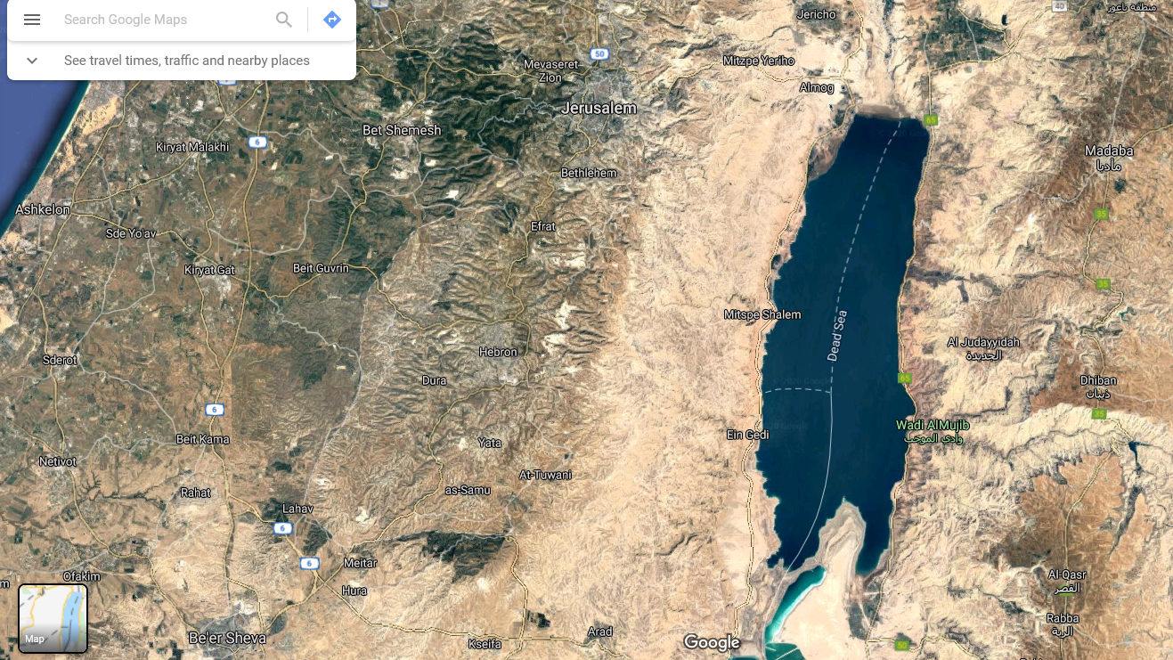
2 Chronicles 20
JERUSALEM
AMMON
¹⁵ He said: ‘Listen, King Jehoshaphat and all who live in Judah and Jerusalem! This is what the Lord says to you: “Do not be afraid or discouraged because of this vast army. For the battle is not yours, but God’s. ¹⁶ Tomorrow march down against them. They will be climbing up by the Pass of Ziz, and you will find them at the end of the gorge in the Desert of Jeruel. ¹⁷ You will not have to fight this battle. Take up your positions; stand firm and see the deliverance the Lord will give you, Judah and Jerusalem. Do not be afraid; do not be discouraged. Go out to face them tomorrow, and the Lord will be with you.”’
ZIZ
EN GEDI
MOAB

Slide 11
2 Chronicles 20
¹⁵ He said: ‘Listen, King Jehoshaphat and all who live in Judah and Jerusalem! This is what the Lord says to you: “Do not be afraid or discouraged because of this vast army. For the battle is not yours, but God’s. ¹⁶ Tomorrow march down against them. They will be climbing up by the Pass of Ziz, and you will find them at the end of the gorge in the Desert of Jeruel. ¹⁷ You will not have to fight this battle. Take up your positions; stand firm and see the deliverance the Lord will give you, Judah and Jerusalem. Do not be afraid; do not be discouraged. Go out to face them tomorrow, and the Lord will be with you.”’
Do not be afraid, however vast the army is.

Slide 12
2 Chronicles 20
¹⁵ He said: ‘Listen, King Jehoshaphat and all who live in Judah and Jerusalem! This is what the Lord says to you: “Do not be afraid or discouraged because of this vast army. For the battle is not yours, but God’s. ¹⁶ Tomorrow march down against them. They will be climbing up by the Pass of Ziz, and you will find them at the end of the gorge in the Desert of Jeruel. ¹⁷ You will not have to fight this battle. Take up your positions; stand firm and see the deliverance the Lord will give you, Judah and Jerusalem. Do not be afraid; do not be discouraged. Go out to face them tomorrow, and the Lord will be with you.”’
Do not be afraid, however vast the army is.
Know that the battle is not yours but God’s. (Ephesians 6:10-20)
¹⁰ Finally, be strong in the Lord and in his mighty power. ¹¹ Put on the full armour of God, so that you can take your stand against the devil’s schemes. ¹² For our struggle is not against flesh and blood, but against the rulers, against the authorities, against the powers of this dark world and against the spiritual forces of evil in the heavenly realms.

Slide 13
2 Chronicles 20
¹⁵ He said: ‘Listen, King Jehoshaphat and all who live in Judah and Jerusalem! This is what the Lord says to you: “Do not be afraid or discouraged because of this vast army. For the battle is not yours, but God’s. ¹⁶ Tomorrow march down against them. They will be climbing up by the Pass of Ziz, and you will find them at the end of the gorge in the Desert of Jeruel. ¹⁷ You will not have to fight this battle. Take up your positions; stand firm and see the deliverance the Lord will give you, Judah and Jerusalem. Do not be afraid; do not be discouraged. Go out to face them tomorrow, and the Lord will be with you.”’
Do not be afraid, however vast the army is.
Know that the battle is not yours but God’s. (Ephesians 6:10-20)
Go only when and where he sends you.

Slide 14
2 Chronicles 20
¹⁵ He said: ‘Listen, King Jehoshaphat and all who live in Judah and Jerusalem! This is what the Lord says to you: “Do not be afraid or discouraged because of this vast army. For the battle is not yours, but God’s. ¹⁶ Tomorrow march down against them. They will be climbing up by the Pass of Ziz, and you will find them at the end of the gorge in the Desert of Jeruel. ¹⁷ You will not have to fight this battle. Take up your positions; stand firm and see the deliverance the Lord will give you, Judah and Jerusalem. Do not be afraid; do not be discouraged. Go out to face them tomorrow, and the Lord will be with you.”’
Do not be afraid, however vast the army is.
Know that the battle is not yours but God’s. (Ephesians 6:10-20)
Go only when and where he sends you.
Stand firm and watch God in action.
Put on the full armour of God, so that you can take your stand against the devil’s schemes.

Slide 15
2 Chronicles 20
²⁰ Early in the morning they left for the Desert of Tekoa. As they set out, Jehoshaphat stood and said, ‘Listen to me, Judah and people of Jerusalem! Have faith in the Lord your God and you will be upheld; have faith in his prophets and you will be successful.’

Slide 16
2 Chronicles 20
²⁰ Early in the morning they left for the Desert of Tekoa. As they set out, Jehoshaphat stood and said, ‘Listen to me, Judah and people of Jerusalem! Have faith in the Lord your God and you will be upheld; have faith in his prophets and you will be successful.’
Have faith in his prophets – listen to what he is saying through his people!

Slide 17
Sunday 19th January 2020
Interpretation of tongues at Brixham Community Church.
“My Children,
This is a time of preparation. This is a time when I am preparing my people for the things that are to come in this land. This time is now.
For very soon I will pour out my Holy Spirit on the streets of this nation and men’s hearts will be in agony because of their sin. The anguish of this land will be very great.
And then they will rush to the places that I have prepared for them – like an oasis in the desert place and there will be reconciliation like never before in this land.
Brother will be reconciled to brother, fathers to children, mothers to daughters, sisters to sisters.
Broken hearts will be mended, cruel words will be cancelled, and truth will be spoken in quiet places.
My children, these are the things that are to come in this land. Heed this word from the Lord.”

Slide 18
“A time of preparation”
⁴ Jehoshaphat lived in Jerusalem, and he went out again among the people from Beersheba to the hill country of Ephraim and turned them back to the Lord, the God of their ancestors. ⁵ He appointed judges in the land…
⁸ In Jerusalem also, Jehoshaphat appointed some of the Levites, priests and heads of Israelite families to administer the law of the Lord and to settle disputes. And they lived in Jerusalem. ⁹ He gave them these orders: ‘You must serve faithfully and wholeheartedly in the fear of the Lord.

Slide 19
“A time of preparation”
“You will seek me and find me when you seek me with all your heart.”
Jeremiah 29:13

Slide 20
“A time of preparation”
“You will seek me and find me when you seek me with all your heart.”
Jeremiah 29:13

Slide 21
“A time of preparation”
God wants all of me.
Even if I withhold the smallest part, it cuts right to the centre, the heart.
“You will seek me and find me when you seek me with all your heart.”
Jeremiah 29:13

Slide 22
“A time of preparation”
God wants all of me.
Even if I withhold the smallest part, it cuts right to the centre, the heart.
“Above all else, guard your heart, for everything you do flows from it.”
Proverbs 4:23
“You will seek me and find me when you seek me with all your heart.”
Jeremiah 29:13

Slide 23
“A time of preparation”
Jehoshaphat’s story is a great picture of how that looks…
God wants all of me.
Even if I withhold the smallest part, it cuts right to the centre, the heart.
“Above all else, guard your heart, for everything you do flows from it.”
Proverbs 4:23
“You will seek me and find me when you seek me with all your heart.”
Jeremiah 29:13

Slide 24
Preparation Pays!
1. A prepared heart puts things right
(Jehoshaphat turns the nation back to God)
2. A prepared heart turns to God first in times of need
(Jehoshaphat resolves to enquire of the Lord)
3. A prepared heart listens and obeys
(Jehoshaphat responds to the Lord’s instruction)
4. A prepared heart is a worshipping heart…

Slide 25
2 Chronicles 20
JERUSALEM
AMMON
²¹ After consulting the people, Jehoshaphat appointed men to sing to the Lord and to praise him for the splendour of his holiness as they went out at the head of the army, saying:
‘Give thanks to the Lord, for his love endures for ever.’
ZIZ
EN GEDI
MOAB

Slide 26
2 Chronicles 20
JERUSALEM
AMMON
²² As they began to sing and praise, the Lord set ambushes against the men of Ammon and Moab and Mount Seir who were invading Judah, and they were defeated…
ZIZ
EN GEDI
MOAB

Slide 27
2 Chronicles 20
JERUSALEM
AMMON
²⁴ When the men of Judah came to the place that overlooks the desert and looked towards the vast army, they saw only dead bodies lying on the ground; no one had escaped. ²⁵ So Jehoshaphat and his men went to carry off their plunder, and they found among them a great amount of equipment and clothing and also articles of value – more than they could take away. There was so much plunder that it took three days to collect it. ²⁶ On the fourth day they assembled in the Valley of Berakah, where they praised the Lord.
ZIZ
EN GEDI
MOAB

Slide 28
2 Chronicles 20
JERUSALEM
AMMON
²⁷ Then, led by Jehoshaphat, all the men of Judah and Jerusalem returned joyfully to Jerusalem, for the Lord had given them cause to rejoice over their enemies. ²⁸ They entered Jerusalem and went to the temple of the Lord with harps and lyres and trumpets.
²⁹ The fear of God came on all the surrounding kingdoms when they heard how the Lord had fought against the enemies of Israel. ³⁰ And the kingdom of Jehoshaphat was at peace, for his God had given him rest on every side.
ZIZ
EN GEDI
MOAB

Slide 29
2 Chronicles 20
Plot summary: Key actions:
God’s people turn back to him (chapter 19) Repentance
The enemy attacks
God’s people seek him Prayer
God speaks
God’s people obey Obedience
God delivers them
God’s people worship him Worship

Slide 30
Prayer focus February 2020
Repentance
Prayer
Obedience
Worship
²³ Search me, God, and know my heart; test me and know my anxious thoughts. ²⁴ See if there is any offensive way in me, and lead me in the way everlasting.
Prepare my heart
Psalm 139

Slide 31
Prayer focus February 2020
Repentance
Prayer
Obedience
Worship
²³ Search me, God, and know my heart; test me and know my anxious thoughts. ²⁴ See if there is any offensive way in me, and lead me in the way everlasting.
Prepare my heart
A prepared heart…
Puts things right
Turns to God first in times of need
Listens and obeys
Is a worshipping heart
Psalm 139

